Slide 1
Camoufler: Accessing The Censored Web By Utilizing Instant Messaging Channels
Piyush Kumar Sharma, Devashish Gosain,
Sambuddho Chakravarty
Presented by Ross Evans

Slide 2
Key Idea
Use IM platforms to tunnel website content
(Slack, Telegram, WhatsApp, Signal, Skype)

Slide 3
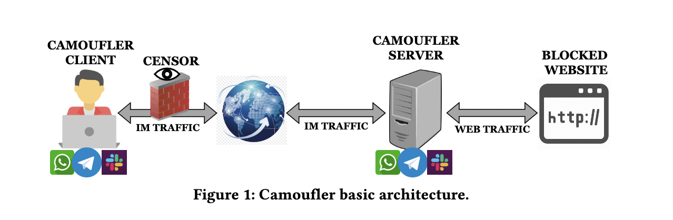

Slide 4
01
Minimized Latency
02
Adequate Throughput
03
Reliability
04
Blocking Resistance
05
Deployment Ease
Why IM Channels?

Slide 5
Threat Model
Nation-State Adversary
Can employ any existing censorship technique
  IP/DNS, URL and Keyword Filtering
  Traffic Analysis
  Packet Tampering/Interference
  etc.
Computationally Bounded
Unwilling to incur economic losses

Slide 6
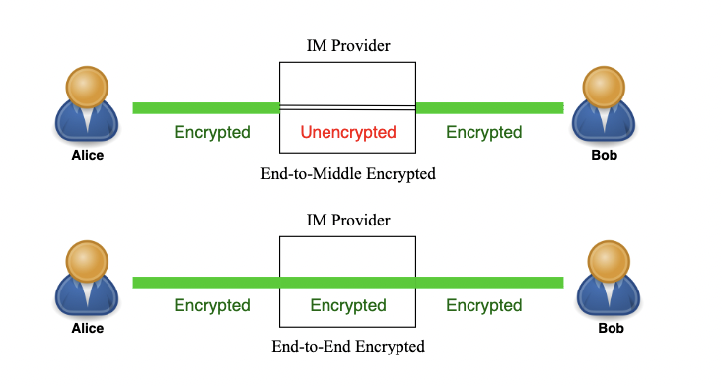
IM Encryption

Slide 7
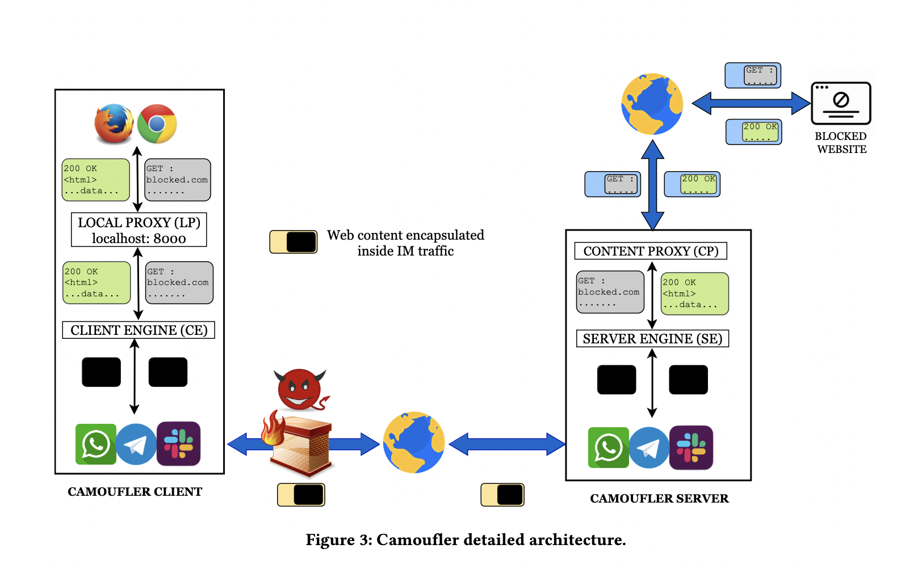

Slide 8
Evaluation
Client and Server located 8300 miles away

Slide 9
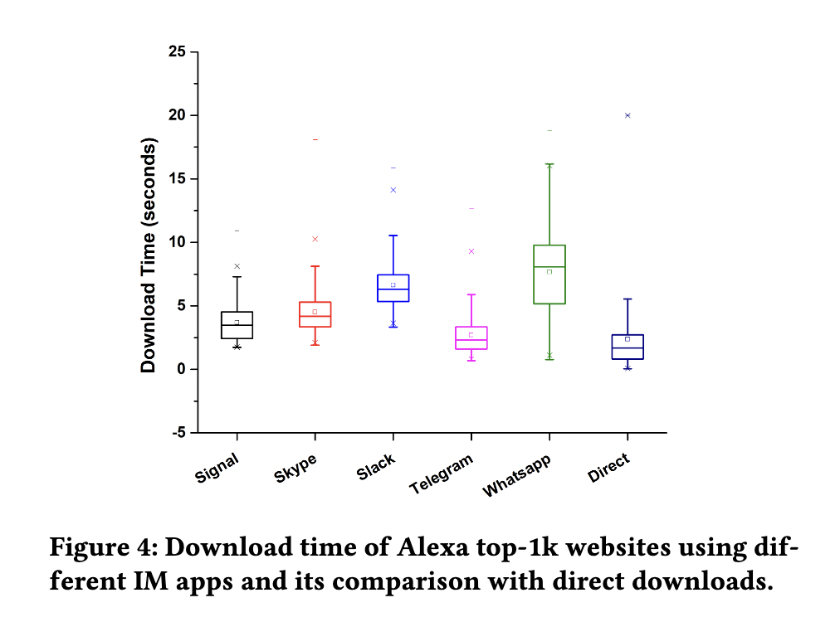

Slide 10
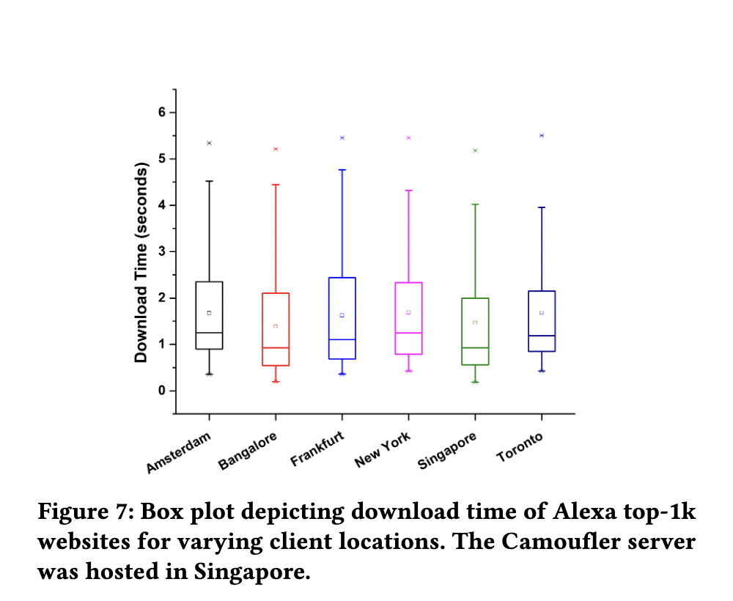

Slide 11
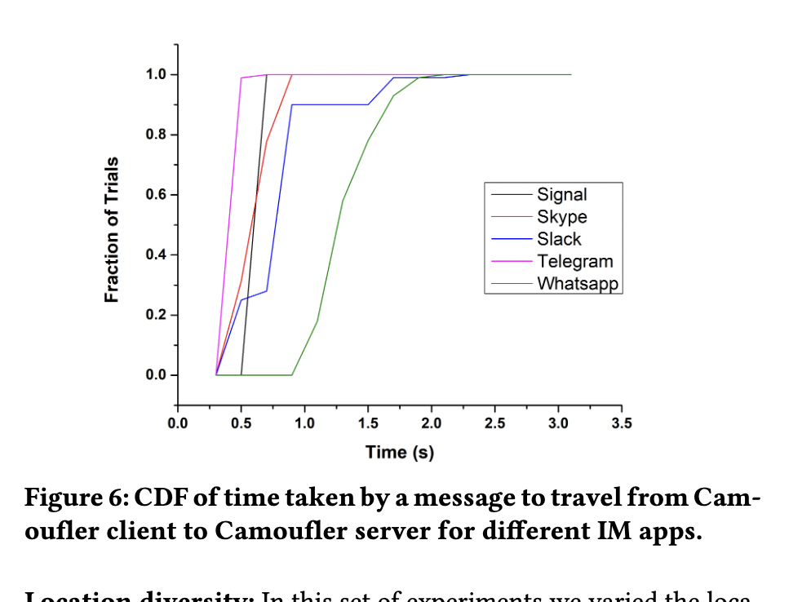

Slide 12
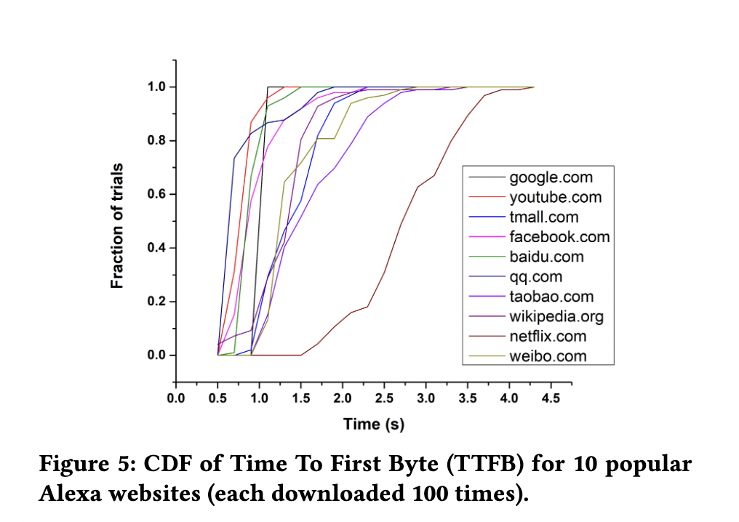

Slide 13
Security Analysis
Specifically, Traffic Analysis

Slide 14
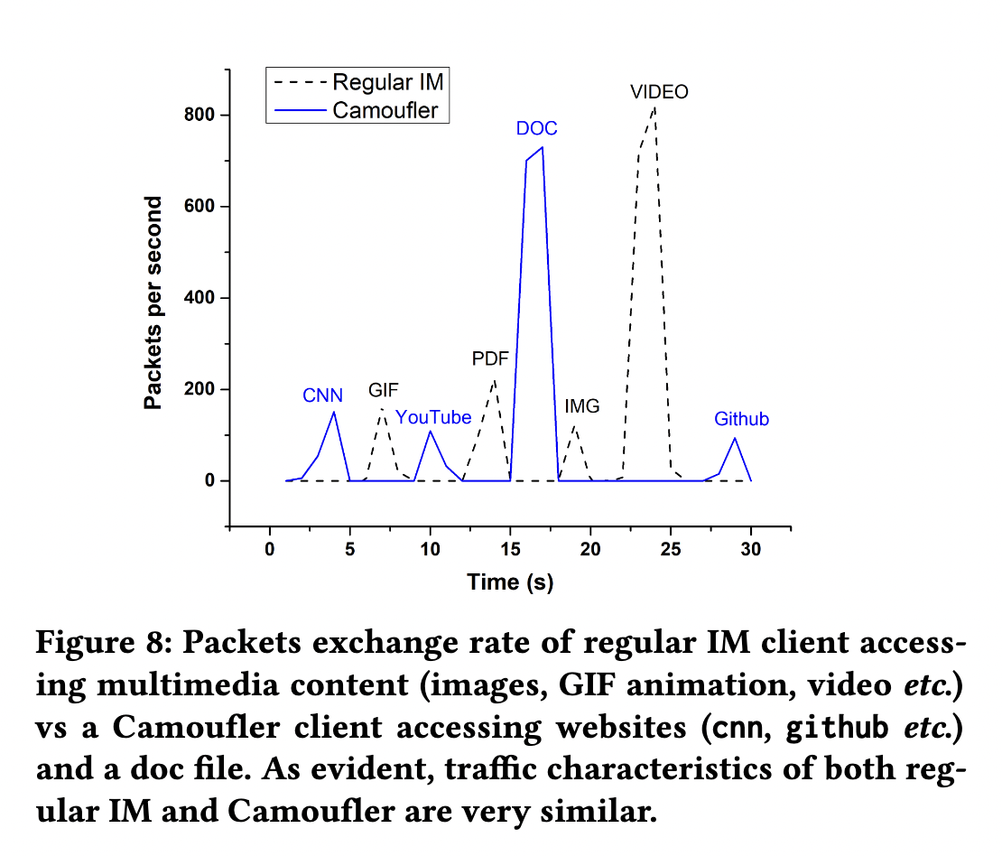

Slide 15
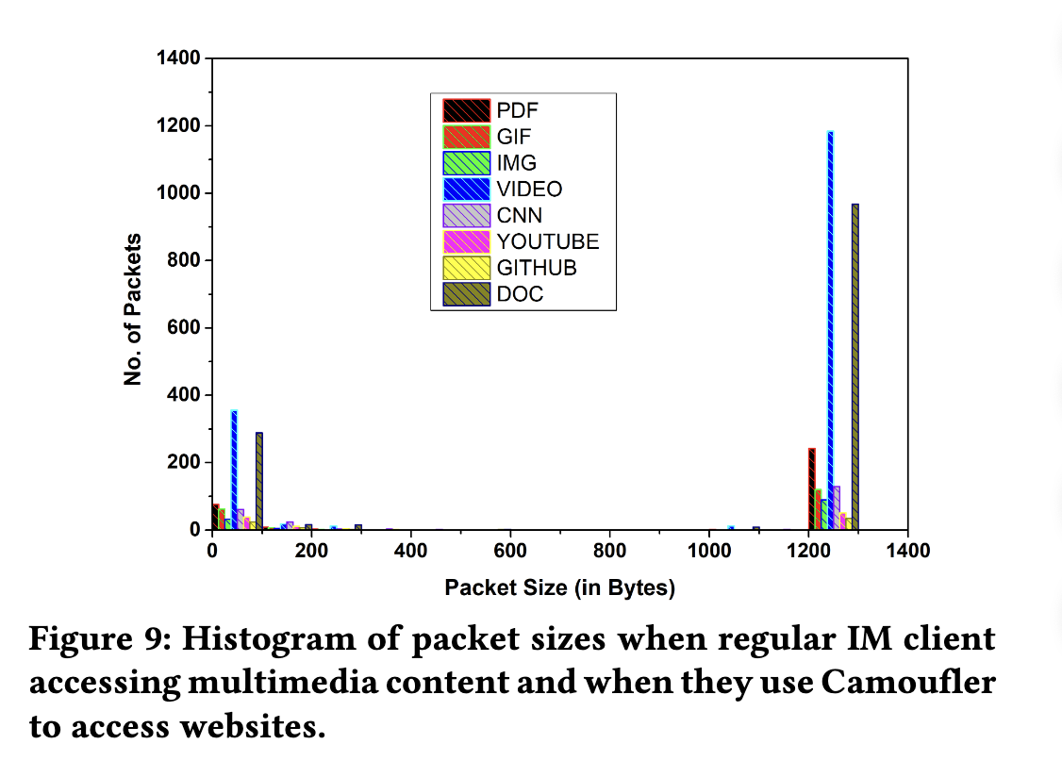

Slide 16
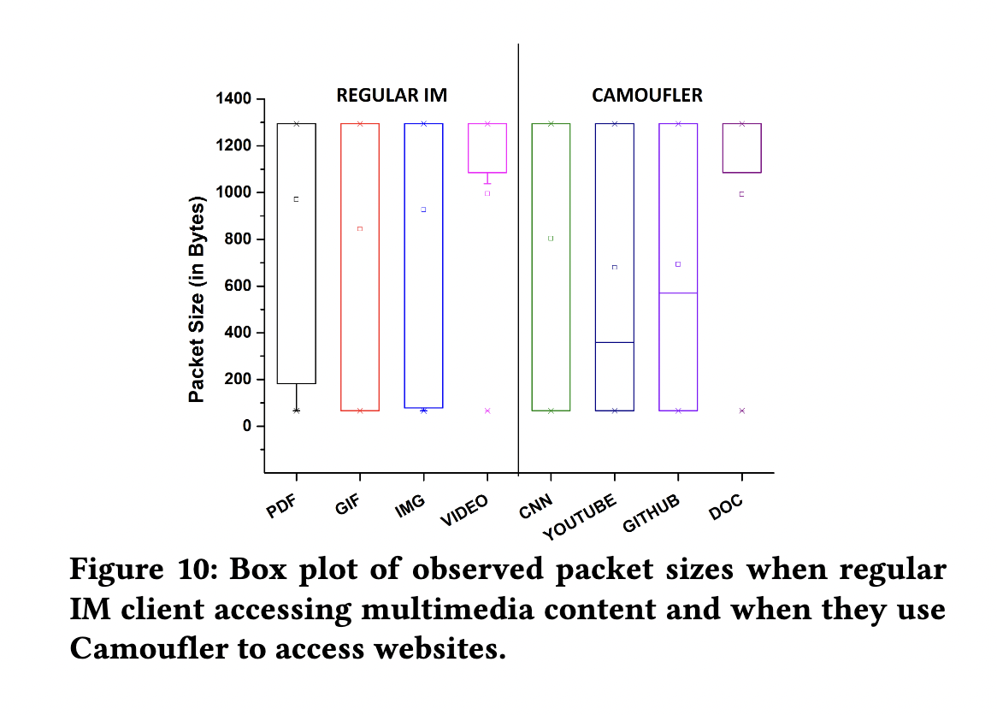

Slide 17
Other Attacks
Traffic Perturbations
Collusion with the IM provider
User Profiling

Slide 18
IM Encryption

Slide 19
Achievements
Blocking Resistance
Deployment Ease
No Cost of Operation (somewhat)
Requisite QoS
Collusion Defense

Slide 20
Discussion Questions
Is the traffic analysis in this paper sufficient?
Is Camoufler effective against an End-To-Middle encrypted IM provider that colludes with the nation-state adversary?
How might IM providers react if Camoufler gained mass adoption?
Was it a good choice to limit Camoufler to HTTP(S)?
Should paper authors have a responsibility to open-source their prototypes?

