Slide 1
Webpage Access in a Blackout
Ross Evans
rpevans@uwaterloo.ca
Notes:
Hello everyone, my name is Ross Evans.
Today I’ll be discussing an in-progress piece of work by myself and my supervisor, Diogo Barradas, concerning Webpage Access in a Blackout.

Slide 2
Imagine one day, you and everyone around you find yourself completely cut off from the internet.
Internet Blackouts prevent citizens within a region from accessing all internet services.
Notes:
Imagine one day you and everyone you know are completely cut off from the internet.
Immediately you would be prevented from contacting loved ones, accessing news sources, using online bank services, etc.
For some people here, this is part of their lived experience.
Internet Blackouts prevent citizens within a region from accessing all internet services.
Thankfully, within Canada, such blackouts are usually restricted to technological failures.
But, in other countries, internet blackouts are weaponized during periods of unrest, conflict, and protests.

Slide 3
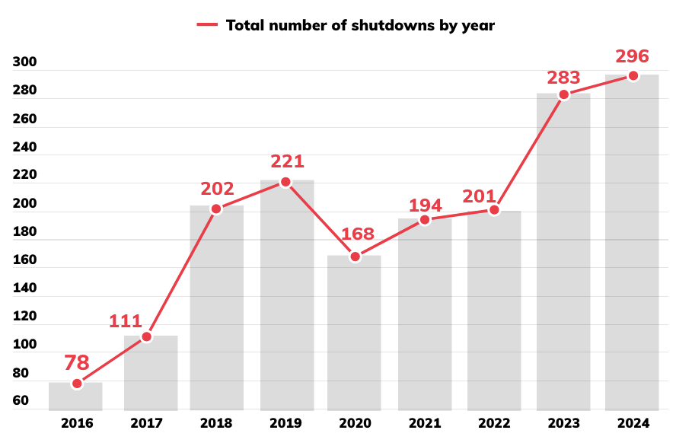
Notes:
Here is a chart from Access Now: the number of blackouts is increasing over time and poses a growing problem.
In 2024 in particular, blackouts have become a staple of modern war strategy, utilized by Russia in Ukraine, by Israel in Gaza, and by China in Myanmar.

Slide 4
What services can we still replicate?
Prior works have focused on messaging and microblogging.
We aim to cache webpages containing useful information.
Notes:
The research question we aim to address is: under such extreme conditions of an internet blackout, what internet use cases can we still replicate.
Prior works have primarily focused on messaging and microblogging scenarios, where nearby smartphones connect over Bluetooth and transmit messages to one another.
We address a different use case: caching webpages for later use during a blackout in a distributed way – like a distributed internet archive.
Through our system, users can access authoritative information such as election news, corruption reports, or even encyclopedic information sources that they would otherwise be unable to access.

Slide 5
Usefulness will be determined via community ratings.
Pre-blackout, users rate webpages according to usefulness, which will determine which pages are cached.
During a blackout, users can request pages and receive them from nearby devices over Bluetooth.
Notes:
A key question to answer is how to determine what pages are actually useful: we do so via community ratings.
Pre-blackout, users will rate websites according to their usefulness, which will determine how pages are cached – more useful pages are replicated across more devices and hence are made more readily available.
Post-blackout, users access pages via short-range connections with other nearby smartphones. For the majority of pages you may wish to access, you should encounter someone storing the page nearby within a short time period.

Slide 6
Types of Users
Leech Users: Cache pages in the background, but do not actively rate pages.
Adversaries
Proactive Users: Actively cache and rate pages according to usefulness.
Proactive Users
Leech Users
Adversaries: Act to disrupt the system wherever possible.
Notes:
For our evaluation and simulations we consider three types of users:
The first and most prominent type of user is the leech: someone who has installed our app pre-blackout but will not invest time in developing community ratings.
We use these users for cache replication: they will accumulate page ratings from others and cache accordingly.
The second most common user type is the proactive user, who actively contributes to community ratings.
Finally, we have some proportion of adversaries in the system, aiming to disrupt its function.

Slide 7
Adversaries may:
Maliciously alter community ratings
Employ jamming in highly populated areas
Serve pages containing misinformation
Notes:
To disrupt the system, the adversary may attempt to maliciously alter community ratings, so that leeches end up caching pages which end up infrequently accessed.
They may employ jamming in highly populated areas post-blackout, so that Bluetooth cannot be used to transfer pages between individuals.
Finally, they may respond to requests from legitimate users with pages that have been altered to contain misinformation.

Slide 8
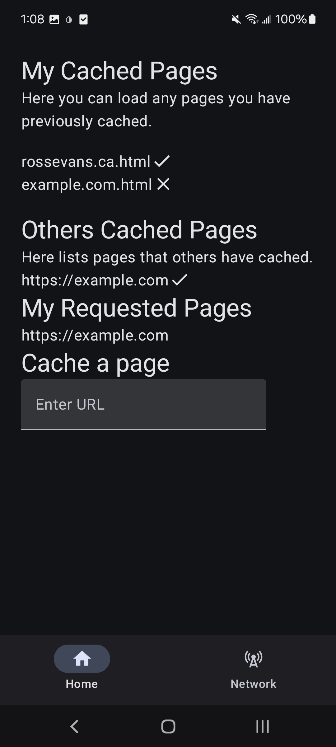
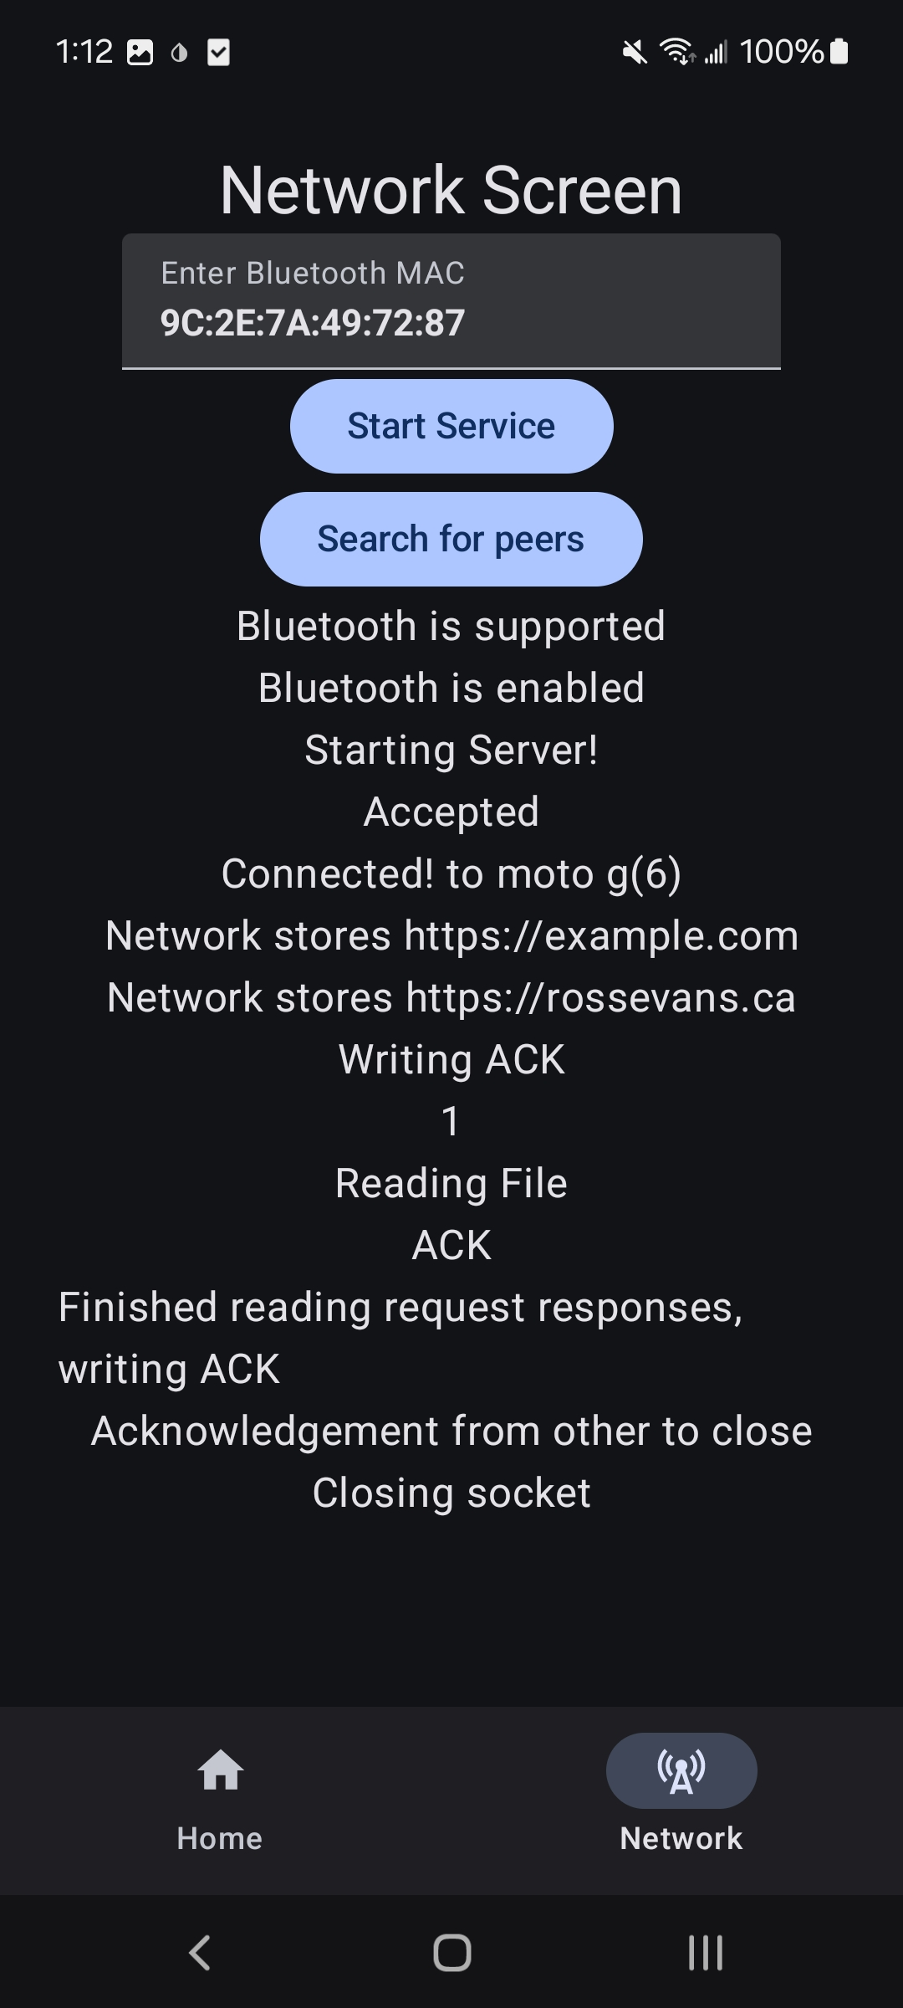
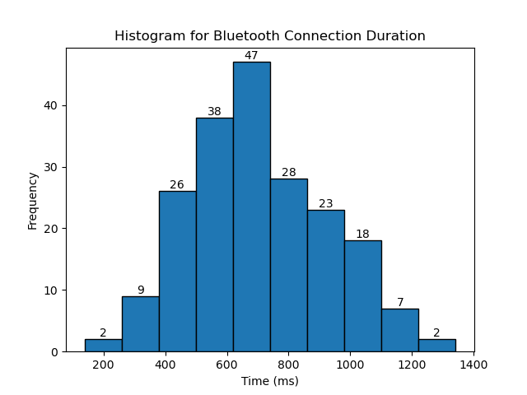
Initial Prototype
Notes:
We have an initial Android prototype we’ve developed.
This prototype has Bluetooth and Wifi-Direct functionality for transferring pages, although no system for ratings yet (minor implementation detail).
We currently mitigate adversaries serving pages with misinformation post-blackout via a checksum stored pre-blackout.
We also intend to develop more complex checksum procedures utilizing perceptual hashing schemes for the cases where a page may have received minor updates since a checksum calculation.

Slide 9
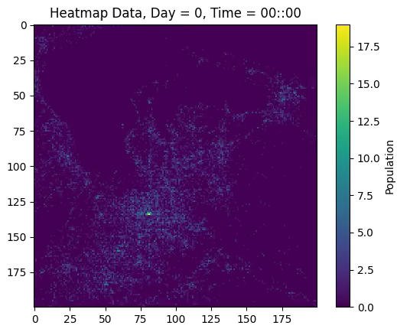
Simulations
Idealized Grid-Based Model
YJMob100k Dataset
Notes:
We have also been developing simulations to test our system’s efficacy.
These include an idealized grid-based model similar to what has been done in prior work.
We are also improving on the realism of prior works by utilizing the YJMob100K dataset (pictured on the left), which includes anonymized data from 100,000 people living in a Japanese city over 75 days, including 15 days of movement during an undisclosed “emergency event”.

Slide 10
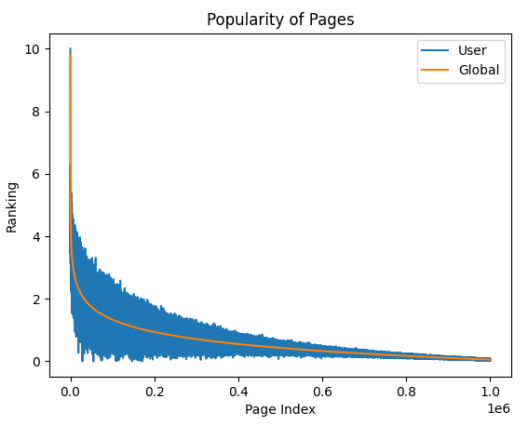
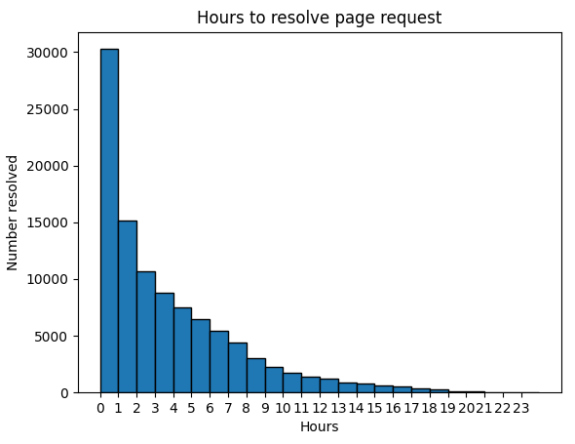
Preliminary Results
Notes:
Our simulation maps page ratings from 0-10 according to a Zipf distribution, where each user follows this distribution with some noise.
Our Zipf distribution is modelled from a paper out of Stanford and Google which provided data comparing website popularity with it’s traffic concentration.
After simulating ranking dispersal and leech caching, we can see that the majority of page requests which are satisfied are done so within a short time period.

Slide 11
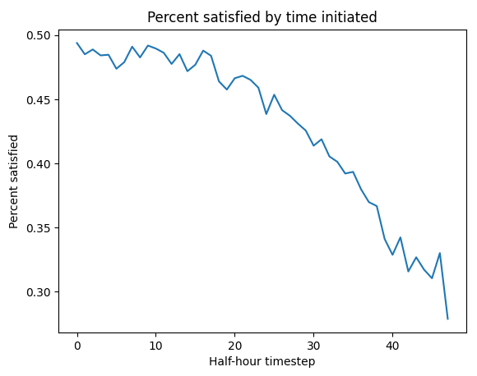
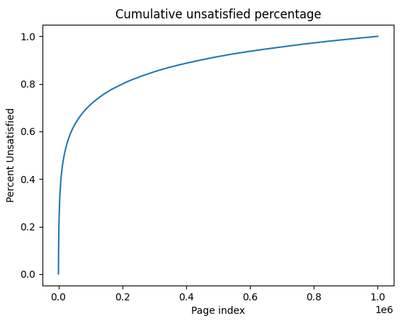
Preliminary Results
Notes:
As the simulation proceeds, it becomes less likely for pages which are requested to be satisfied in the limited time remaining.
We can also see from the figure on the right, that most unsatisfied requests are occurring due to pages in the long-tail of the distribution.

Slide 12
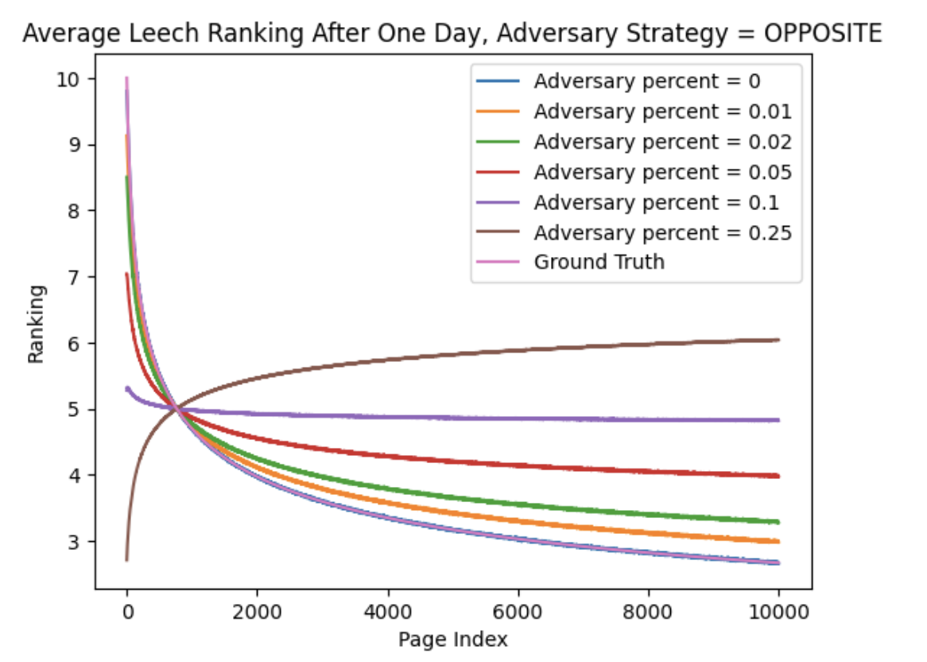
Preliminary Results
Notes:
Finally, we have a graph showing how page ratings are affected when adversaries are introduced which attempt to negatively influence rankings.
As the percentage of adversaries approach the percentage of proactive users, leeches struggle to effectively differentiate useful pages, near all pages end up at a rating of 5, eventually flipping such that useful pages are rated very low scores.

Slide 13
Thank you! Questions?
Ross Evans
rpevans@uwaterloo.ca
Notes:
This is all for the presentation.
We hope to build on these results, improve the baseline performance, and show the efficacy of our system across a variety of scenarios.
Thank you for listening, I will take questions now.

