Slide 1


ProofFrog: A Tool for Verifying Game-Hopping Proofs
Ross Evans Douglas Stebila
prooffrog.github.io
Notes:
Hi everyone, welcome to my presentation on ProofFrog. This tutorial intends to take you through some of the aspects of ProofFrog’s design.

Slide 2
Outline
What is ProofFrog
Syntax + Functionality
Example – One-Time Secrecy => IND-CPA security for PKEs
prooffrog.github.io

Slide 3
What is ProofFrog?
prooffrog.github.io

Slide 4
Key Points
Computational Model, Domain Specific Language
Improved ease of use for the average cryptographer
Proofs via sequences of games for indistinguishability properties
prooffrog.github.io

Slide 5
Implementation
Developed in Python
ANTLR for grammar/parser of domain-specific language
Utilizes Z3 and SymPy
prooffrog.github.io

Slide 6
Approach
Checks that each pair of games in a sequence is either behaviorally equivalent or leveraging a reduction to use an indistinguishability assumption
Checks behavioral equivalency by performing several transformations to coax games into a canonical form
Currently, minimal user direction for proofs, wholly automated
prooffrog.github.io

Slide 7
Current Working Examples
List provided at prooffrog.github.io/examples.html
Standard Textbook Examples (Joy of Cryptography)
IND-CPA$ => IND-CPA
Security of a length tripling-PRG
Encrypt-Then-MAC is IND-CCA secure
One-Time-Secrecy implies IND-CPA security for PKEs (Hybrid Argument!)
IND-CPA security of a hybrid encryption scheme
prooffrog.github.io

Slide 8
Limitations
Trusted computing base is large
Transformations are not proven
No operational semantics
No type-checking/rejection of ill-defined programs
So far, only verified on textbook examples
prooffrog.github.io

Slide 9
Syntax + Functionality
prooffrog.github.io

Slide 10
Structure
ProofFrog supports 5 constructs for writing proofs with: Primitives, Schemes, Games, Reductions, and Proofs
Primitives – define constants and operations for a cryptographic construction (think abstract classes)
Schemes – extend from primitives, provide method definitions (think concrete classes)
Games – Define internal state and oracles provided to an adversary during an experiment
Reductions – Types of games that can access oracles from a challenger
Proofs – Define variables, state assumptions, theorem to prove, sequence of games
prooffrog.github.io

Slide 11
Types
Void, Bool, Int, BitString<Length>
Tuples (TypeA * TypeB), Optionals (Type?), Map<Type1, Type2>
Set<Type>, Array<Type, Length>
Can also define in a proof Set X which can then later be used as type indicating that elements belong to this set
Must be defined in immutable let section – useful for when sets for a construction do not matter in the proof
(Note: Type-Checking currently un-implemented)
prooffrog.github.io
Notes:
ALSO MENTION GROUPS – CAN MODEL THE SETS BASED ON THE GROUP THINGS

Slide 12
Statements
Assignment: Int x = 2;
Uniform Sampling: Ciphertext c <- Ciphertext;
If Statements: if (b1) { … } else if (b2) { … } else { … }
Numeric for-loops: for (Int I = 0 to 5) { … }
For-loops over sets/lists: for (Int x in S) { … }
Return statements: return x;
prooffrog.github.io

Slide 13
Transformations
Composing games and reductions via inlining
Expansion of tuples
Copy propagation
Sorting statements according to a dependency graph
Detecting copied slices
Symbolic computation
Detecting duplicated fields
User-specified assumptions
prooffrog.github.io

Slide 14
Transformations – Part 2
Branch elimination
Collapsing identical branches
Removing unnecessary fields
Canonicalization of return statements, variable names, not operations, tuples
Removing unreachable statements
prooffrog.github.io

Slide 15
Additional Functionality
Native support for hybrid arguments
Use Z3 to check if conditions are equivalent
prooffrog.github.io

Slide 16
Example
prooffrog.github.io

Slide 17
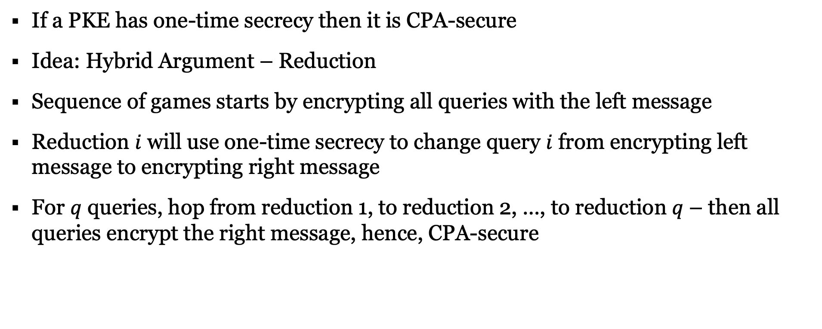
Theorem:
If a PKE has one-time secrecy then it is CPA-secure
Idea: Hybrid Argument – Reduction
Sequence of games starts by encrypting all queries with the left message
Reduction $i$ will use one-time secrecy to change query $i$ from encrypting left message to encrypting right message
For $q$ queries, hop from reduction 1, to reduction 2, …, to reduction $q$ – then all queries encrypt the right message, hence, CPA-secure
prooffrog.github.io

Slide 18
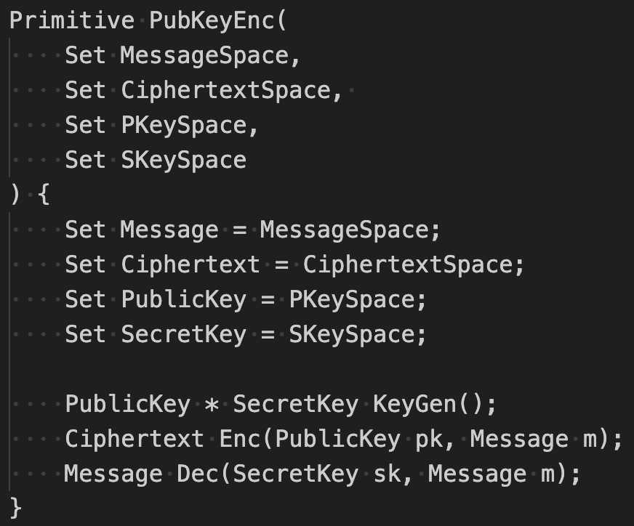
Public-Key Encryption Primitive
Parameterization of Primitive ->
Sets primitive are defined over ->
Tuple type ->
Method signatures ->
prooffrog.github.io

Slide 19
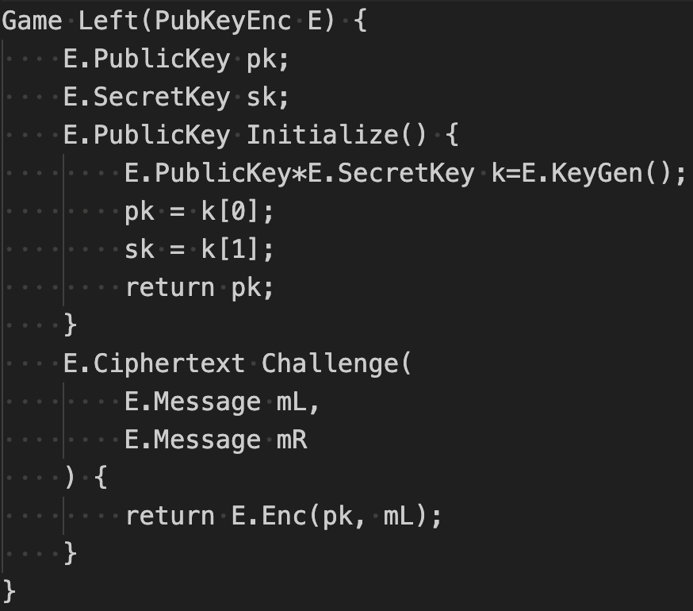
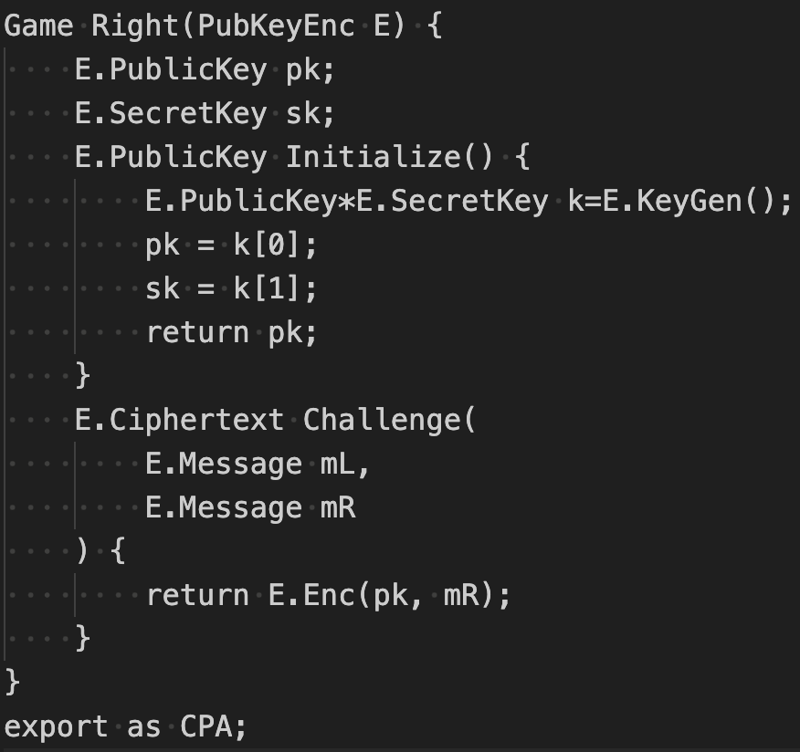
IND-CPA Security Definition
prooffrog.github.io

Slide 20
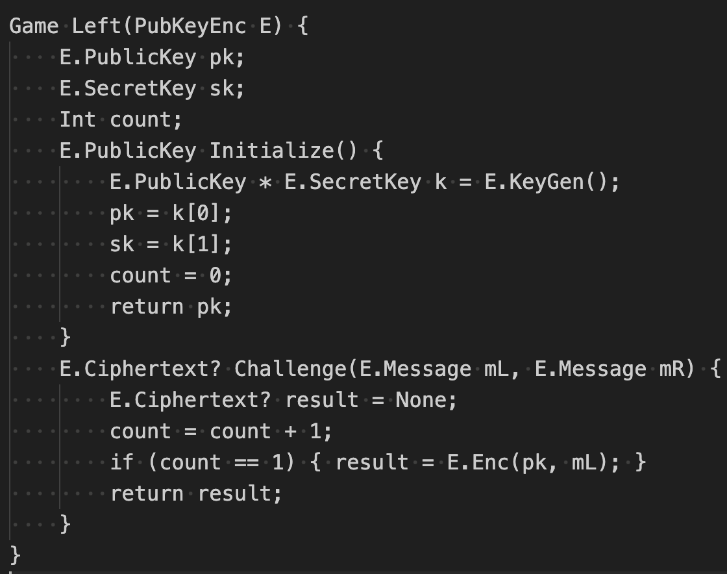
One-Time Secrecy Definition
prooffrog.github.io

Slide 21
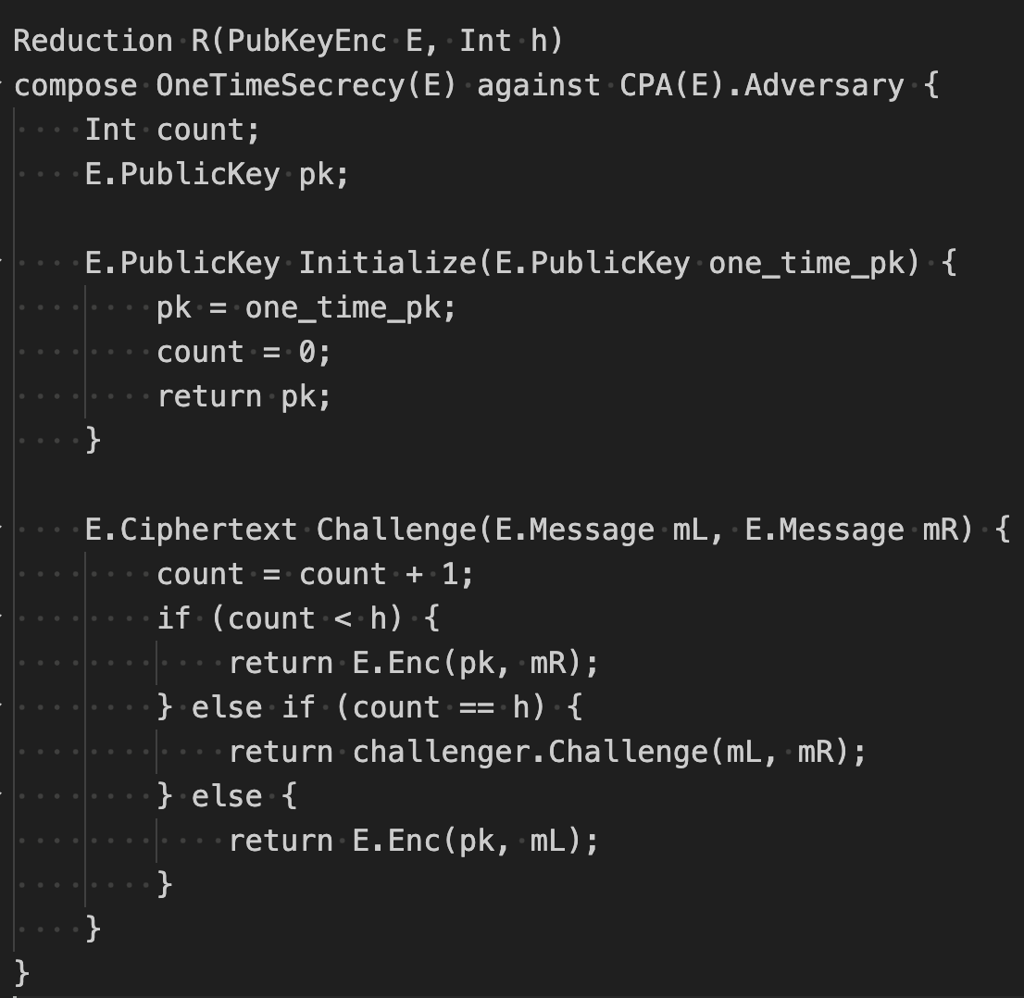
One-Time Secrecy Definition
prooffrog.github.io

Slide 22
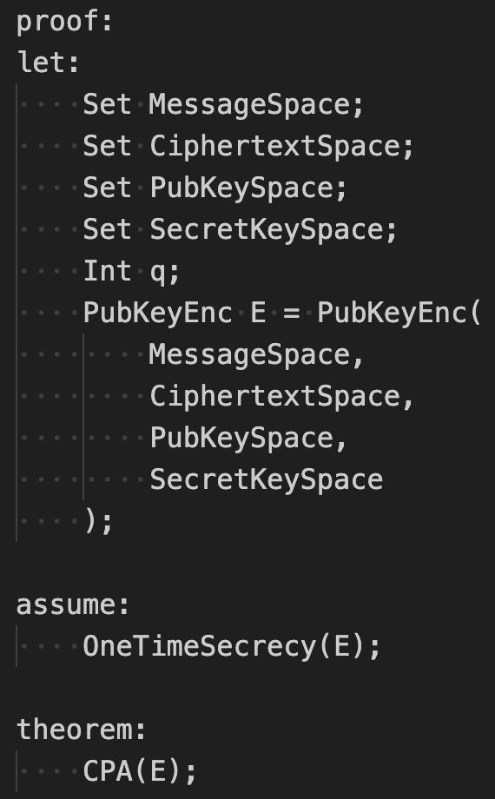
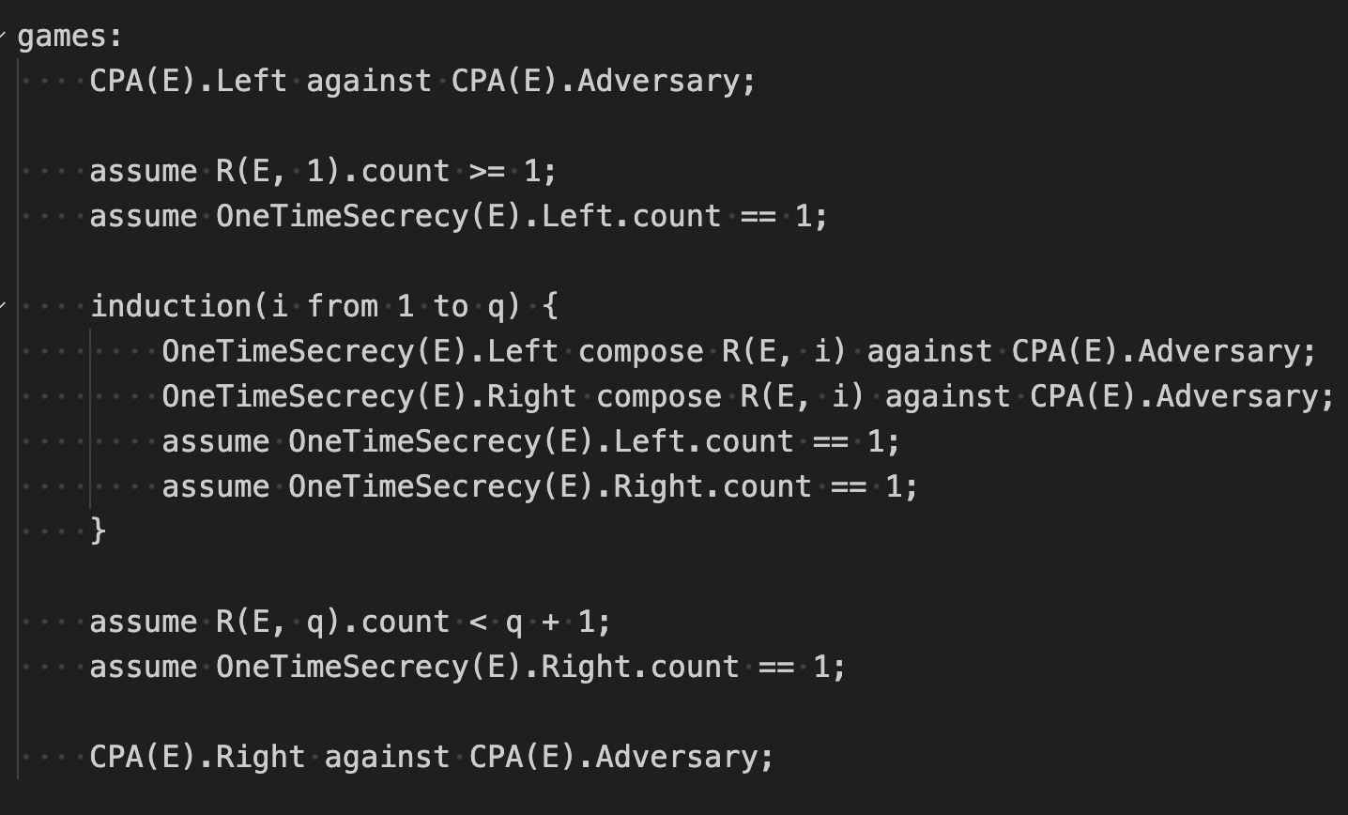
Proof File
prooffrog.github.io

Slide 23
Demo Output
proof_frog prove examples/Proofs/PubEnc/OTS=\>CPA.proof
Can also use the –v flag to see additional output
prooffrog.github.io

Slide 24
Future Work
Interoperability with other tools
Export ProofFrog’s verification steps to more established proof assistants for extra confidence
Check steps ProofFrog can’t manage in other stronger proof assistants
Automatic typesetting, exporting diagrams to LaTeX
Do basic type checking for reductions even if proof can’t be verified
Improve reasoning for long-term state, lists, maps
prooffrog.github.io

Slide 25
Finally:
Example problems – see website
Proving that if a scheme is IND-CPA secure with multiple challenges then it is also IND-CPA secure with one challenge (practice writing one reduction)
Proving that if a scheme is IND-CPA secure with one challenge then it is also IND-CPA secure with multiple challenges (hybrid argument, assumptions)
prooffrog.github.io

Slide 26
Thank You

